Slide 1
Let me not the marriage
William Shakespeare
B.COM 1
SEMISTER 2
COMPULSORY ENGLISH

Slide 2
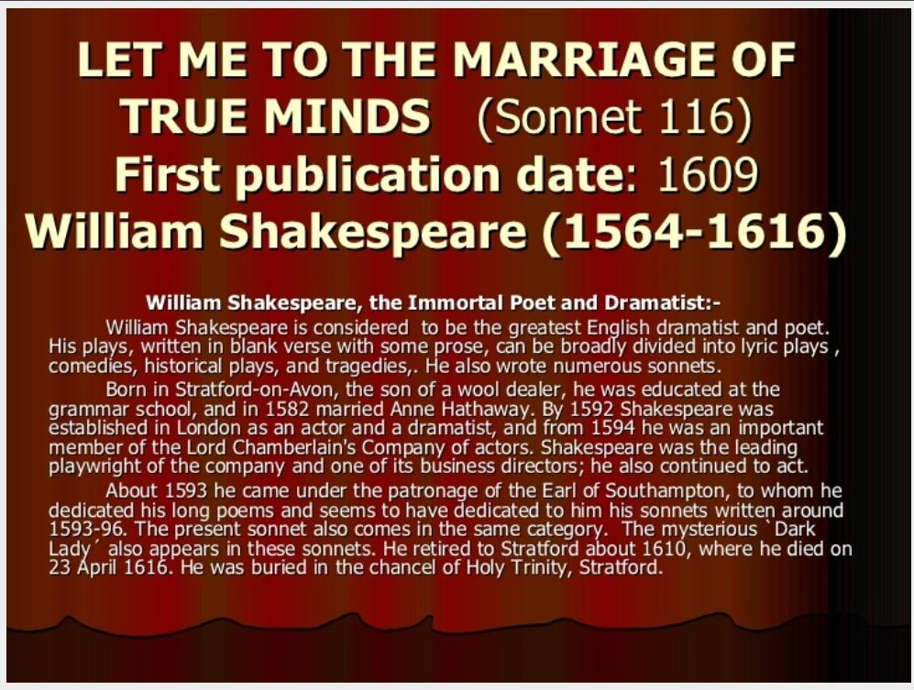

Slide 3
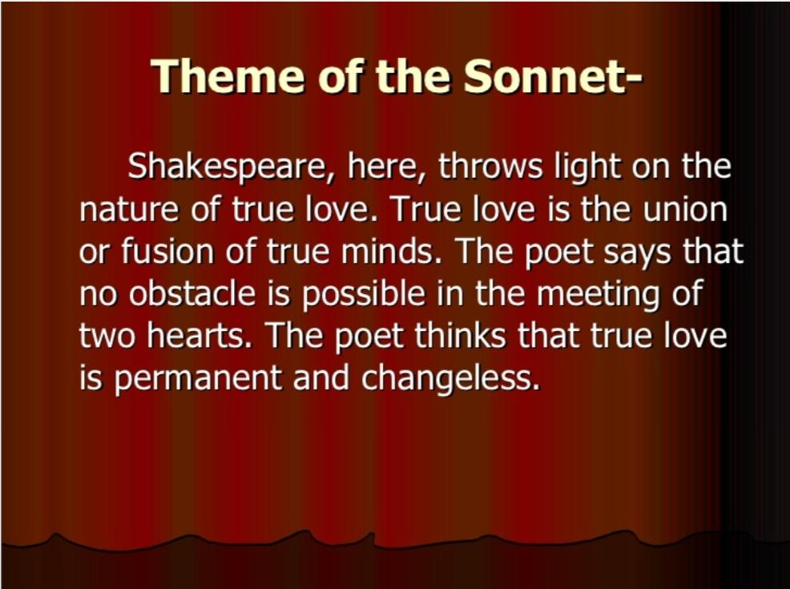

Slide 4


Slide 5
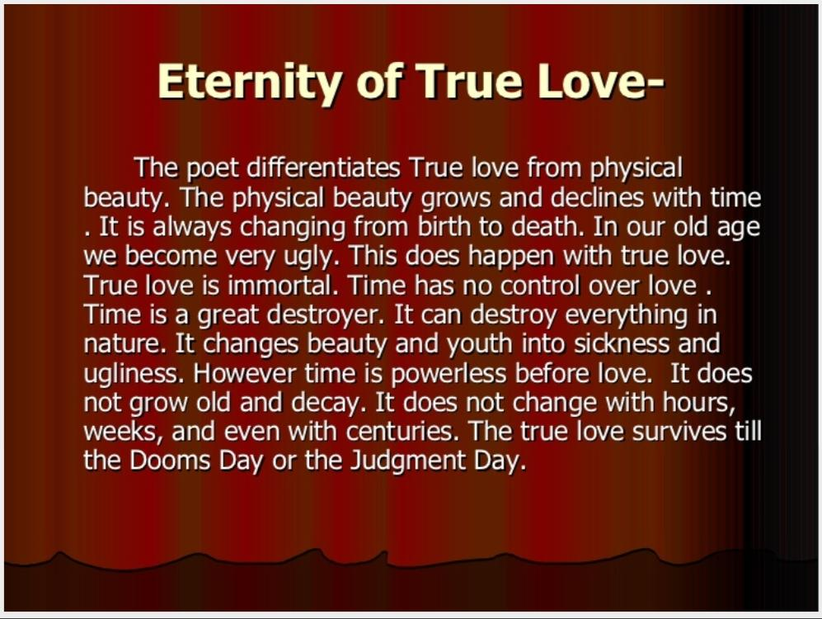

Slide 6
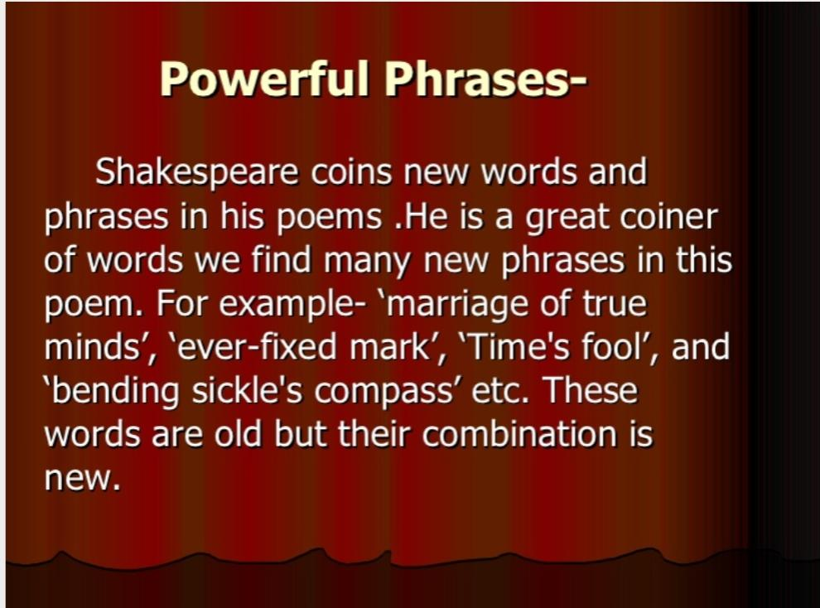

Slide 7
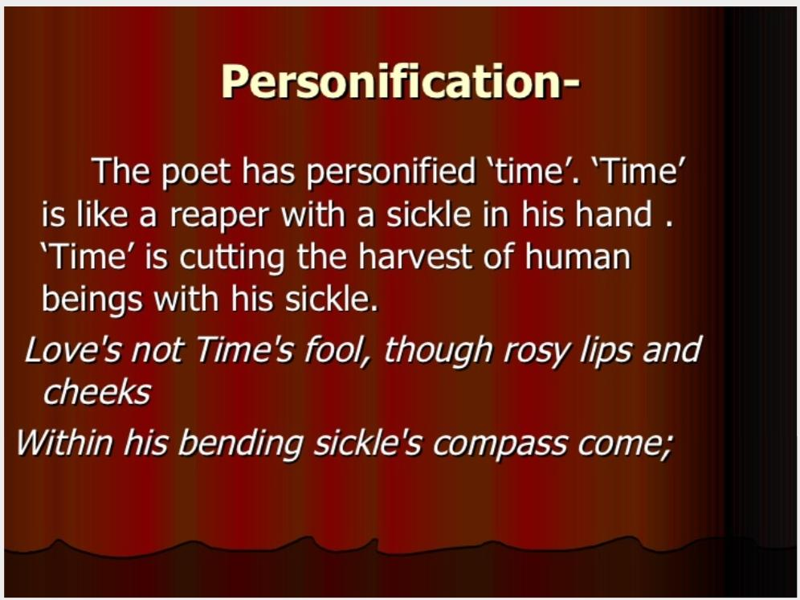

Slide 8
